Slide 1
Team ATM
Andrew Gacek, Tim Chan, Matthew Nolan

Slide 2
Times
Unfortunately, our group did not finish. We would get most of the way through the competition codes and then crash.
However, we did manage to implement some cool advanced features that are functional on their own.
The issue that prevents the code from working likely lies in how we react to different hazards occuring at the same time.

Slide 3
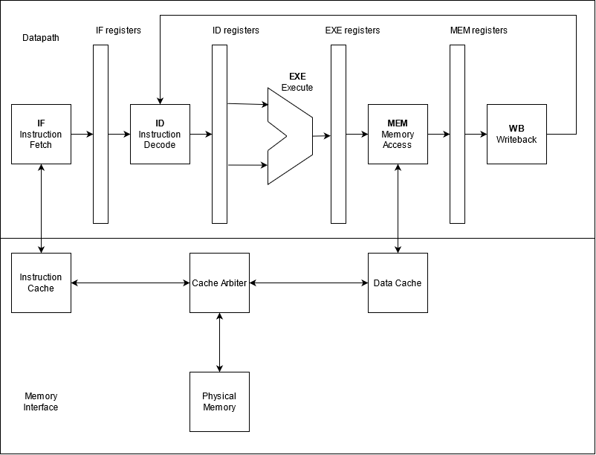
Processor Design
Overall Design:
5-stage pipelined processor with hazard detection and handling, and forwarding
Advanced Features:
M-extension
Parameterized cache
Variation of TAGE Branch Predictor

Slide 4
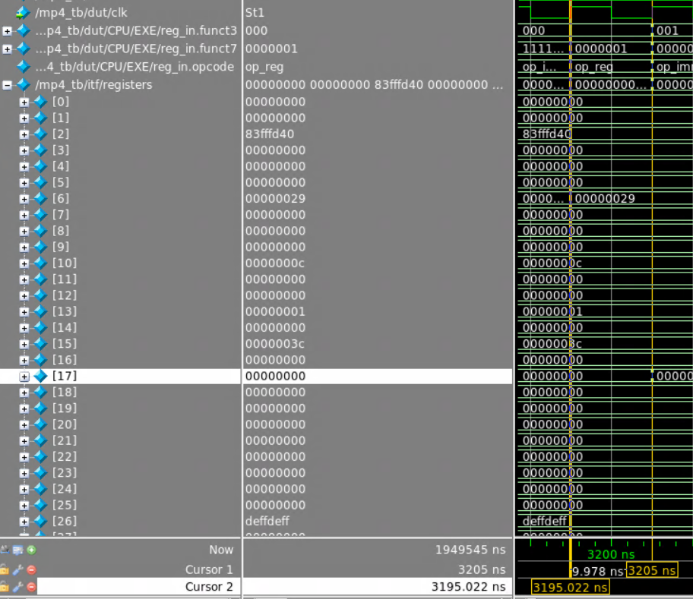
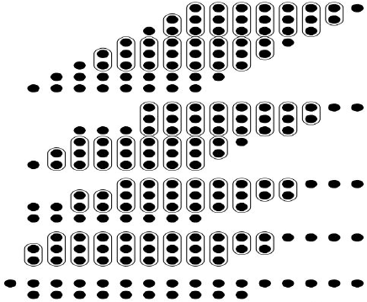
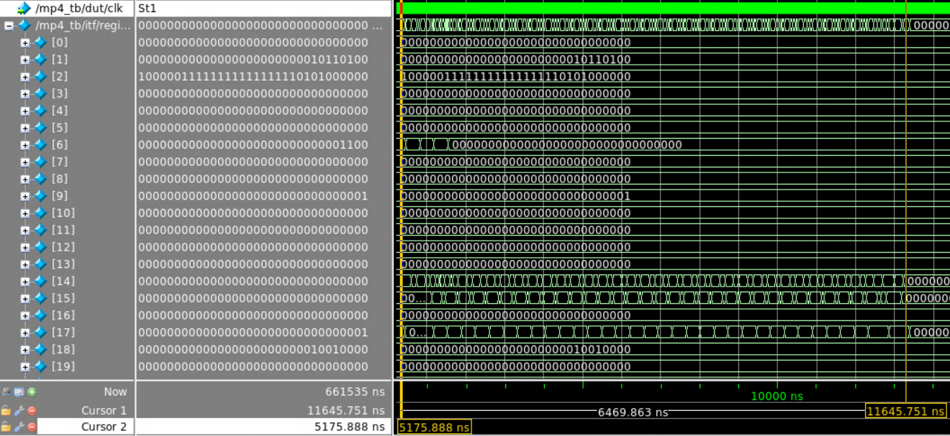
Advanced Feature Performance:
Wallace Tree Multiplier
M-extension:
Without multiplier, multiplication takes 647 cycles (6470ns)
With basic add-shift multiplier, multiplication takes 32 cycles (320ns)
With advanced Wallace Tree multiplier, multiplication takes 1 cycle (10ns)
Without Multiplier
With Multiplier
Diagram of 8x8 Wallace Tree multiplier

Slide 5
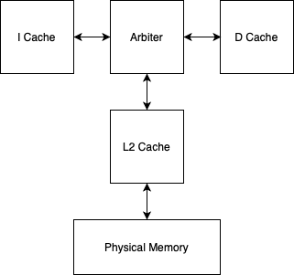
Advanced Feature Description
Parameterized L2-Cache
Single cache connected between arbiter and physical memory
Parameterized number of ways and sets
Replaced default LRU with a parameterized pseudo LRU design

Slide 6
Performance
Tested on CP3 code
 | 2 way 4 set | 4 way 4 set | 4 way 8 set | 8 way 16set
Miss % | 72.3 | 39.3 | 4.65 | 2.96
Hit % | 27.7 | 60.7 | 95.35 | 97.04

Slide 7
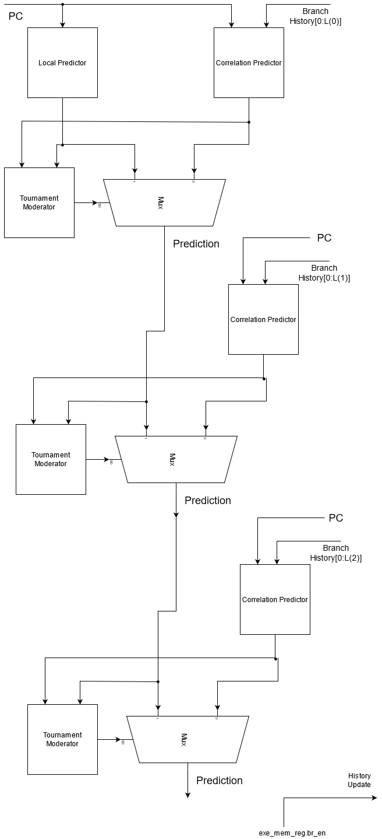
Branch Predictor
The basic idea is to create a hierarchical tournament of different correlated branch predictors. The correlated predictors use a combination of the address and the branch history as a tag to the table.
This is very similar to the L-TAGE branch predictor. However, there is no loop predictor.

Slide 8
Branch Predictor Results
Simple Example Code Run to Highlight the Performance of the different predictors.
Test code starts with taking a branch 255 times.
Then it follows a T-T-N pattern until the end
Predictor | # Taken | # Not Taken | # Correct | # Incorrect | Accuracy (%)
Local Predictor | 510 | 130 | 545 | 87 | 86.2
Correlated- History = 1 | 510 | 130 | 545 | 87 | 86.2
Correlated- History = 2 | 508 | 132 | 632 | 8 | 99.0
Correlated- History = 3 | 508 | 132 | 632 | 8 | 99.0
Final Prediction | 508 | 132 | 632 | 8 | 99.0
*The third predictor should be length 4 to complete the geometric series, but that is not an important detail.

Slide 9
Analysis
Used office hours
Communication
Connected RVFI monitor/made sure it was working
Making sure every checkpoint was thorough in order to avoid having to debug the entire project

Slide 10
Questions?

